Slide 1
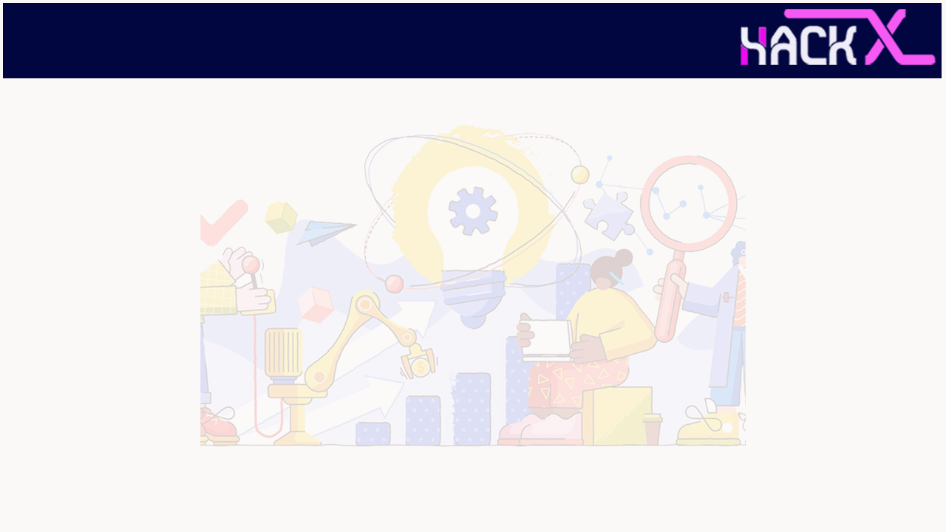
SLIDE 1
Team SSIG
2. Members Name and Phone Numbers (DHARANIKUMAR A B
7904514672)
3. IOT
4. LIQUID LEVEL MONITIRING SYSTEM

Slide 2
SLIDE 2
The drinking water is one of the main problems affecting many countries now, in the same way we are not actually using the rain water properly. The misuse of water leads no many problems like uncontrolled water flow etc. Last year 2018 Kerala undergrown a deep flood because of huge rain due to that all the dams in Kerala opened simultaneously. It creates a huge flood in Kerala.

Slide 3
SLIDE 3
The LCD screen is used to display the status of the level of liquid in the containers. Whereas a web page is built to show the status to the user monitoring it. The web page gives a graphical view of the containers and highlights the liquid level in color in order to show the level of liquid. The LCD screen shows the status of the liquid level. The system puts on the buzzer when the level of liquid collected crosses the set limit. Thus this system helps to prevent the wastage of water by informing about the liquid levels of the containers by providing graphical image of the containers via a web page. The drinking water is one of the main problems affecting many countries now, in the same way we are not actually using the rain water properly. The misuse of water leads no many problems like uncontrolled water flow etc. Last year 2018 Kerala undergrown a deep flood because of huge rain due to that all the dams in Kerala opened simultaneously. It creates a huge flood in Kerala. Around 370 peoples died in Kerala due to this flood. The main reason is people are not aware of dam opening so the peoples near to the river all are washed off. Most of the dams are not having a digital sensing for water level. All the dams are having only scale measurement so failed to give information about damn opening. Water level monitoring system solves this problem It will give right information about water level in reservoir and it will avoid wastage water i

Slide 4
SLIDE 4
This project IOT Liquid Level Monitoring system is a very innovative system which will inform the users about the level of liquid will prevent it from overflowing. To demonstrate this the system makes use of 4 containers. For this the system uses ultrasonic sensors placed over the containers to detect the liquid level and compare it with the container's depth..

Slide 5
SLIDE 5
Hardware Requirements
*Arduino UNO
*Nodemcu ESP8266
*Ultrasonic Sensor
Software Requirements
*Arduino IDE
*Embedded C

Slide 6
SLIDE 6
evel Sensors have a vast application in Consumer, Commercial and industrial processes. IOT based Liquid level Monitoring project is designed in a way that it can be used to remotely monitor the level of liquid indoors and out, like measuring tanks, wells, ponds, canals, and streams.

Slide 7
Thank you

